Slide 1
Academic Year 2020-2021 Minuteman Brief
Mr. Donovan Lea and CPT Greg Bucci
USACC RMID GRFD POC
Notes:
Title Slide

Slide 2
References
AR 145-1: Senior Reserve Officers’ Corps Program: Organization, Administration, Training
AR 601-210: Regular Army and Army Reserve Enlistment Program
CC Reg 145-1: Army ROTC Scholarship Policy, Administrative, and Procedural Instructions
CC Reg 145-9: Reserve Officers’ Training Corps Accessioning and Commissioning
USACC OPORD 20-03-014: Reserve Component Annual Minuteman Scholarship Program for Academic Year (AY) 2020-2021
SMOM XX-XXX: FY20 ARNG Minuteman Scholarship Campaign

Slide 3
Agenda
AY 2020-2021 Minuteman GRFD scholarship program
Minuteman Nomination Process
Minuteman Eligibility Requirements
Processing documents
Minuteman Guaranteed Reserve Forces Duty (GRFD) Scholarship benefits
Best practices

Slide 4
AY20-21 Minuteman Program
Minuteman Scholarships are designed this year to bring new applicants to ROTC Programs
All prospects nominated are incoming freshman or those that have four years remaining in college
The Minuteman Scholarship process has changed to track all nominations from start to finish
4-year Scholarships may only be awarded to candidates attending a host program or a (Extension / Cross-town) Public University at resident rates
All scholarships are based on available funding

Slide 5
Nomination Process
Nomination source works with ARNG/USAR local Rep to identify possible Nominees
Nomination source nominates prospect based on meeting Scholarship requirements per AR 145-1 & CC PAM 145-1
Nomination source works with ARNG/USAR local representative to send Nomination to USACC HQ RMID Reps:
ARNG Nominations sent to Donovan Lea
Donovan.h.lea.ctr@mail.mil (502) 624-1739
USAR Nominations sent to CPT Greg Bucci
Gregory.r.Bucci.mil@mail.mil (502) 624-7695
USACC HQ RMID Reps verify nomination and send through USACC BDE for Further processing
ROTC Program builds scholarship packet and scholarship app in CCIMM while working with local ARNG/USAR Rep to get prospect fully qualified
Not eligible for Minuteman
(process stops here)
Eligible
NO
Nomination not valid
Not Accepted
Ineligible
Cadet accepts conditional offer for the Minuteman Scholarship
If qualified USACC program sends packet through BDE to USACC HQ RMID ARNG/USAR Rep to fully process. GRFD Control # is issued and Offer letter awarded.
MISSION COMPLETE
Recruiter contacts ROTC to complete 167-R, and obtains a DA 597-3 and CC 203-R and MM offer letter into applicants ERM, then initiates workflow
Recruiter enlists Cadet per
AR 601-210 for RC Enlist after offer is made
Scholarship Offered
Key
Recruiter, OSM, or
USAREC
ROTC Personnel (ROO, PMS etc.)
Nomination Source (TAG, CASA, ARA, MSC)

Slide 6
Dates & Deadlines
30MAR2020 processing begins at USACC HQ
01SEP2020 deadline for Fall 2020 benefits
01DEC2020 deadline for Spring 2021 benefits
Scholarship packets can take weeks to process. We ask that nominations are submitted NLT two weeks prior to each deadline giving the USACC Program personnel sufficient time to complete the nomination process.

Slide 7
“Redistribution”
Starting 02SEP20, all unused nominations will be removed from nomination sources and managed at USACC HQ RMID.
Nomination sources may still nominate and have no limit to the number of nominations submitted. However, USACC will develop an order of merit list (OML) and award remaining allocations on a competitive basis with a list released the first week of December. This process is called Competitive Redistribution of Unused Allocations by Components.
***NOMINATIONS DO NOT GUARANTEE A SCHOLARSHIP DURING PHASE II***

Slide 8
“Redistribution”
This phase will depend upon the number of unused nominations and the available funding.
This phase ends with the release of scholarship awardees offers.
***NOMINATIONS DO NOT GUARANTEE A SCHOLARSHIP DURING PHASE II***

Slide 9
Nursing Majors
Nursing major applicants who are seeking GRFDs are only authorized for USAR minuteman recipients that will be SMP Cadet in a Medical Service Unit
Nursing majors are not authorized for ARNG applicants

Slide 10
Nomination Allocations
ARNG - The Adjutant Generals (TAG)
8 nominations per TAG (432 total nominations for ARNG)
-2 nominations for 4YR, 6 nominations for 3AD
ARNG or USAR - Civilian Aide to the Secretary of the Army (CASA)
4 nominations per CASA (currently 436 total nominations)
-1 nomination for 4YR and 3 nominations for 3AD

Slide 11
Nomination Allocations
USAR - Major Subordinate Commander (MSC)
6 nominations per MSC (180 total nominations for USAR)
-2 nominations for 4YR, 4 nominations for 3AD
USAR - Army Reserve Ambassadors (ARA)
4 nominations per ARA (456 total nominations for USAR)
-1 nomination for 4YR and 3 nominations for 3AD

Slide 12
Transferring Allocations
TAGs may transfer to other TAGs prior to 01SEP20 deadline with prior approval from the USACC RMID
MSCs may transfer to other MSCs prior to 01SEP20 deadline with prior approval from the USACC RMID
A memo is required to transfer
Example: if a TAG is transferring to another TAG, the memo should state total allocations transferring with lengths of scholarships

Slide 13
Transferring Allocations
State TAGs and MSCs that transfer their allocations to another command will not receive replacement allocations
CASAs and ARAs may not transfer allocations
Transferring between TAGs and MSCs are discouraged

Slide 14
Eligibility Requirements
Currently in ARNG/USAR or eligible to enlist
U.S. Citizen
Between the ages of 17-26
Valid MEPS Chapter 2 Physical for enlistment
DoDMERB Physical for ROTC “scheduled” for scholarship offer and completed DoDMERB to contract with ROTC
Pass a APFT to contract
Be in compliance with AR 600-9 Body composition standards
Official College / University acceptance letter
4YR and 3AD Scholarship applicants require: 2.5 High School GPA, 1000 SAT or 19 ACT
Once contracted maintain 2.0 College GPA
Participate in Simultaneous Membership Program (SMP)
Once commissioned, 8x year service obligation actively drilling in designated component

Slide 15
Nomination Memos
Nomination Memo should contain:
Name of candidate
Name of institution
Length of scholarship
Hand written or digitally signed signature block
All nominations should be submitted to Mr. Donovan Lea (ARNG) and CPT Greg Bucci (USAR) NLT two weeks prior to each deadline
If multiple names are on one memo, please provide 1-3 above in memo

Slide 16
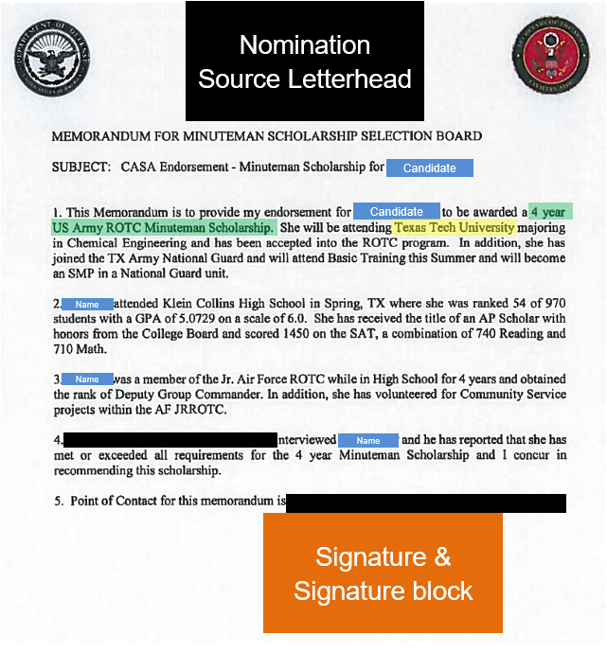
Nomination Example
Candidates Name
Length of Scholarship
College / University
Signature Block

Slide 17
ROTC Program Tasks
Prior to submitting scholarship packet the following documents will need to be processed from the ROTC personnel on Campus:
CC Form 139-R, Cadet Enrollment Record and upload into CCIMM
All applicants should be in a “A” CCIMM enrollment status or scholarship applicant status

Slide 18
ROTC Program Tasks
Candidates must complete the Cadet Background Experience Form (CBEF)
PMS interview and scholarship board conducted with SAL points uploaded into CCIMM
CH 2 MEPS Physical scheduled
DoDMERB Physical scheduled and scheduling date uploaded in CCIMM

Slide 19
Scholarship Packet
Minuteman Scholarship Packet Requirements:
Nomination Memo
CC Form 145-1-5, ROTC Scholarship Request Form
CC Form 104-R, Cadet Academic Plan if provided, but needs to be completed by end of first term
SMP Agreement
(ARNG) NGB Form 594-1, ARNG SMP Agreement
(USAR) DA Form 4824, USAR SMP Agreement
(USAR) LOA/Memo from the accepting Unit Commander
High school transcripts
SAT / ACT Score Form (1000 SAT / 19 ACT minimum)

Slide 20
Scholarship Packet cont.
CC Form 145-1-5, ROTC Scholarship Request Form (double click to see
ARNG Example
USAR Example
Fillable form

Slide 21
Scholarship Packet cont.
ARNG SMP Agreement – NGB Form 594-1 (double click image for pdf)
Example
Fillable

Slide 22
Scholarship Packet cont.
USAR SMP Agreement with Unit LOA – DA Form 4824 and LOA example (double click image for pdf)
DA Form 4824 Example
Unit LOA Example
Fillable DA Form 4824

Slide 23
Documents for Contracting
Contracting documents for Minuteman Scholarship:
Complete CC Form 201-R (double click image for pdf)

Slide 24
GRFD Scholarship Benefits
A GRFD contracted scholarship Cadet can earn:
Full Tuition/Fees or Room/Board ($10K per year)
$1200 a year book stipend
ROTC Cadet stipend each month $420
Earn E-5 drill pay upon contracting
CH 30/33 if eligible
State Tuition option (ARNG) (varies state to state)

Slide 25
Best Practices
Never promise a scholarship
Delegation of Authority for TAGs/MSCs
We will accept delegation of authority signatures, if a memo has been written from the TAG or MSC giving the authority to whomever.
Schools should counsel the cadet in writing on benefits & options
Additional counseling from RC recruiter & RC Unit
Make sure scholarships are accepted w/in 21 days after making the offer
Keep updated RC Unit information (CDR, 1SG, Unit Admin.)

Slide 26
UNITED STATES ARMY CADET COMMAND
FT KNOX, KY
CPT Gregory Bucci
USACC USAR Scholarships Program Manager
502-624-7695
gregory.r.bucci.mil@mail.mil
Mr. Donovan Lea
ROTC Support Administrator
ARNG Contractor
502-624-1739
donovan.h.lea.ctr@mail.mil
Notes:
First level (Arial 26)
Second level (Arial 24)
Third level (Arial 20)
Fourth level (Arial 18)
Formatting
Slide is set to automatically format. Use this slide as your starting point.
Do not go below fourth level bullet
Paragraph spacing is set at “before 6pt”
Use the designated bullet style for each level
Paragraphs are formatted with hanging indents
Additional layouts available under “Slides” “Layout” or “New Slide” in the tool bar

Slide 27
Notes:
Final Slide

