Slide 1
Mil-Ball Appearance Regulations
2018-2019

Slide 2
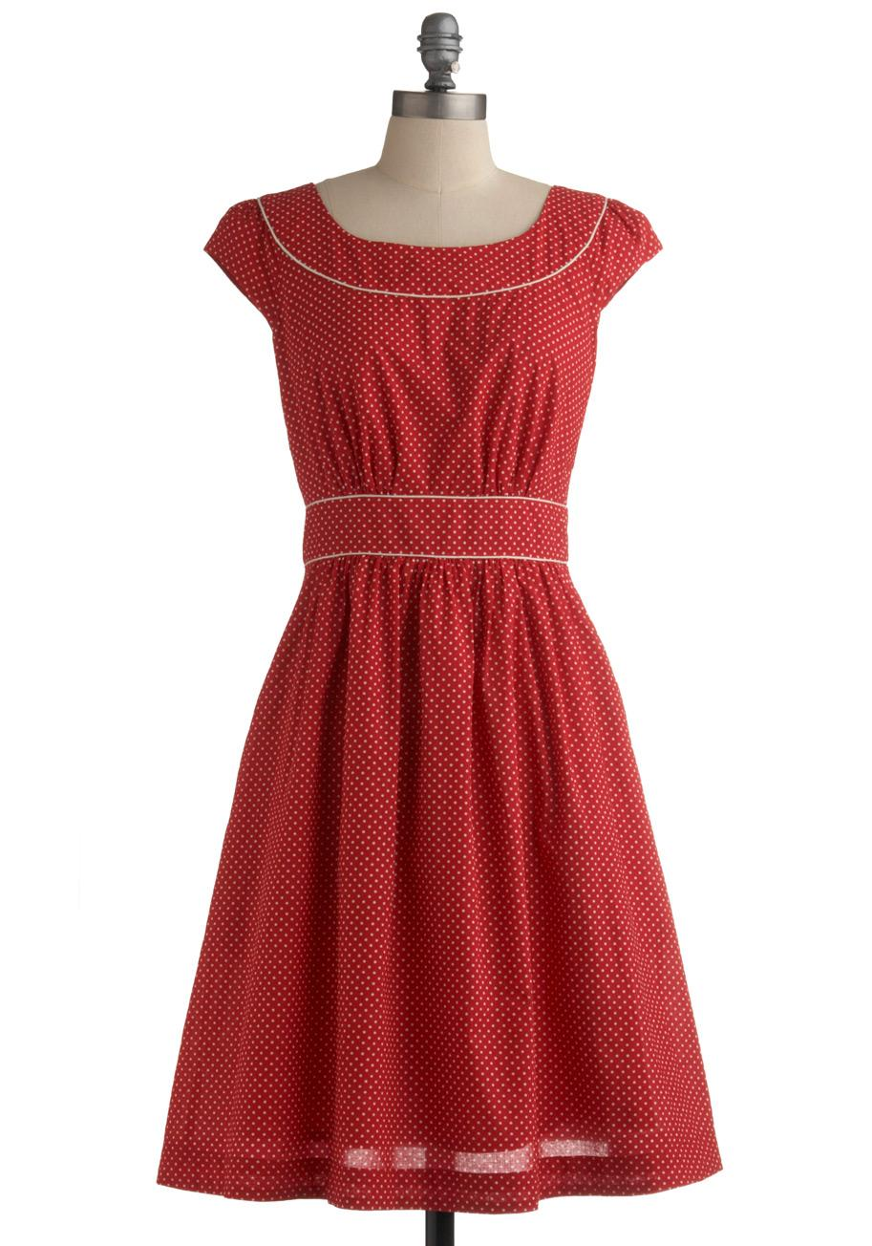
Females
Female cadets can wear either their Class B uniform or a formal dress that is within school dress code. Bring flip-flops, slippers….you must have shoes on at all times!

Slide 3
Military Ball Dress Regulations
Your Dress Can Be:
Strapless
Two Piece (2 in. max)
High - Low
Most Styles
Dress Can Not Be:
See through/mesh in midsection
Higher than 3 inches above the knee
Lower than the small of the back
Excessive in cleavage

Slide 4
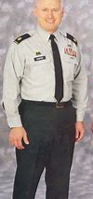
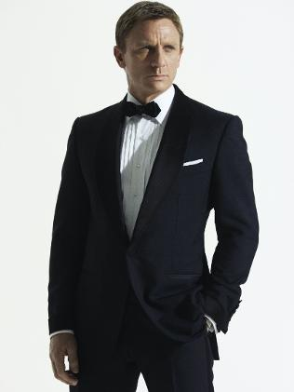
Males
Males will wear their Class B uniform (unless informed otherwise) - Tie will be provided in addition
Male guests must either wear a suit or tux…. No exceptions!!!

Slide 5
What Happens If you don’t conform to these rules?
You Will NOT ENTER!!!

Slide 6
If You Would Like to Borrow a Dress _____.
Contact Destinie Locke or have your psg/pl leave your contact info with “dress borrow” in their platoon boxes.
Not all sizes are offered, and the dresses will be lent out for Mil-Ball only.

