Slide 1
Air Force Reserve Officer Training Corps Detachment 295

Slide 2
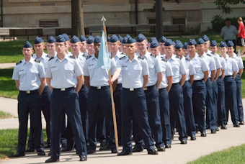
Overview
Det 295
What is AFROTC?
AFROTC Requirements
Cadet Progression
Weekly Time Commitment
Career Opportunities
Scholarships
Active Duty Benefits
Cadet Experiences
Q&A

Slide 3
Detachment 295
Hosted by UofL
Academic classes / LLAB held at UofL
Fitness Assessments (FA) given at UofL
Crosstown students can exercise at their campus / on their own*
Crosstown Universities
Indiana University Southeast
Jefferson Community & Technical College
Bellarmine University
Spalding University
Embry-Riddle Worldwide

Slide 4
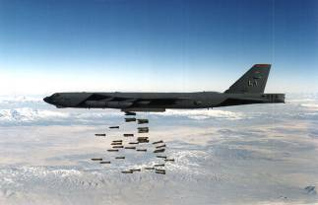
Program Expectations
We expect our cadets to:
Live the Air Force Core Values
Integrity First
Service Before Self
Excellence In All We Do
Be totally fit (emotionally, mentally, spiritually, physically & socially)
Embrace challenges and conquer them
Prepare for their future

Slide 5
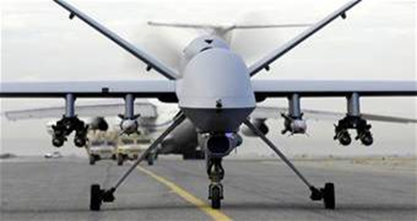
What is AFROTC?
One of three commissioning sources for the Air Force:
United States Air Force Academy (USAFA)
Officer Training School (OTS)
AFROTC (Largest)
4-year academic program ending with a bachelor’s degree and a commission into the USAF (Guard, Reserve, or Active Duty)

Slide 6
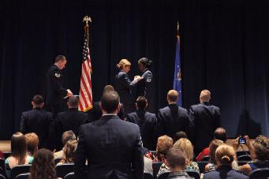
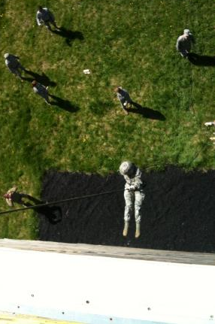
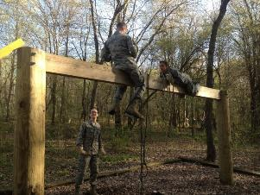
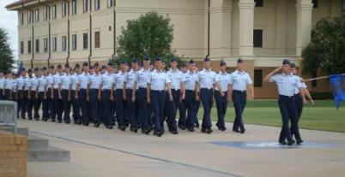
ROTC Mission
AFROTC Mission: To develop premier leaders of character for the Air Force

Slide 7
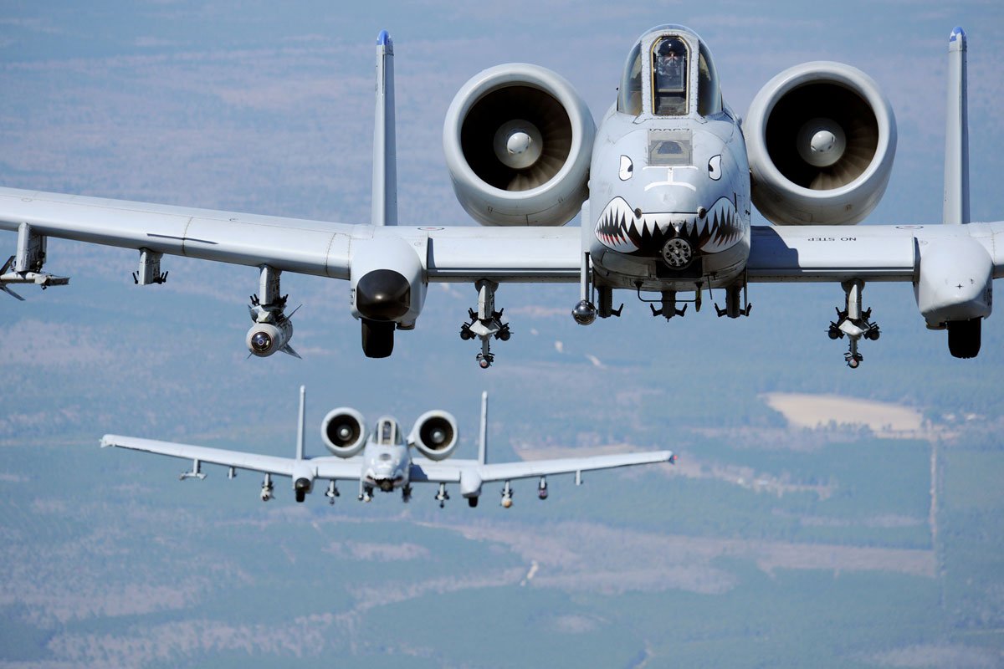
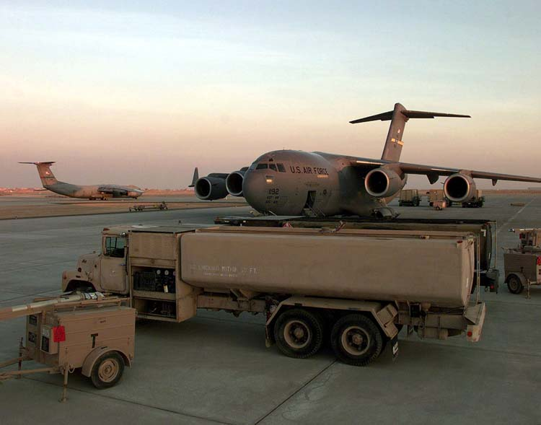
ROTC Requirements
Graduation Requirements:
Accredited bachelor’s degree of your choosing
Commissioning Requirements:
US Citizen
DoDMERB
Attend/complete AFROTC academic classes
Pass a Physical Fitness Assessment
1 minute pushups, 1 minute situps, 1.5 mile run
AFOQT
Complete Field Training
Demonstrate Effective Leadership Traits

Slide 8
Cadet Progression
NATIONAL SECURITY AFFAIRS I/II & PREPARATION FOR ACTIVE DUTY
(3 CREDITS/SEM)
2 WEEK
FIELD TRAINING
FOUNDATIONS OF
U.S. AIR FORCE I/II
(1 CREDIT/SEM)
AIR
POWER I/II
(1 CREDIT/SEM)
LEADERSHIP
STUDIES I/II
(3 CREDITS/SEM)
FRESHMAN
SOPHOMORE
JUNIOR
SENIOR
GMC
GENERAL MILITARY COURSE
POC
PROFESSIONAL OFFICER COURSE
LEADERSHIP LABORATORY
(1 CREDIT/SEM)

Slide 9
Weekly Time Commitment
 | Freshman | Sophomore | Junior | Senior
Physical Training | 3 | 3 | 3 | 3
Leadership Laboratory | 2 | 2 | 2 | 2
AFROTC Academics | 1 | 1 | 3 | 3
Cadet Position | 0 | 1 | 2* | 2*
Totals | 6 | 7 | 10* | 10*
*Time is in Hours/Individual Experiences May Vary*

Slide 10
Air Force Officer Career’s
Over 100+ Career Fields
Pilot
Air Battle Management
Combat Control
Air Liaison Officer
Aircraft Maintenance
Space and Missile Operations
Developmental Engineering
Manpower & Quality Management Personnel
Scientific Research
Acquisitions
Communications
Cyberspace Operations
Combat Systems
Health Facilities Architect/Engineer
Logistics
Services
Medical Corps
Remotely Piloted Aircraft Pilot
Navigator
Air Field Operations
Intelligence
Security Forces
Special Investigations Officer
Civil Engineering
Financial Management
Contracting
Weather
Public Affairs
Munitions/Missile Maintenance
Behavioral Sciences
Planning and Programming
Chemist/Nuclear Chemist
Special Tactics Officer
Band Officer
Chaplain
Lawyer
Combat Rescue Officer

Slide 11
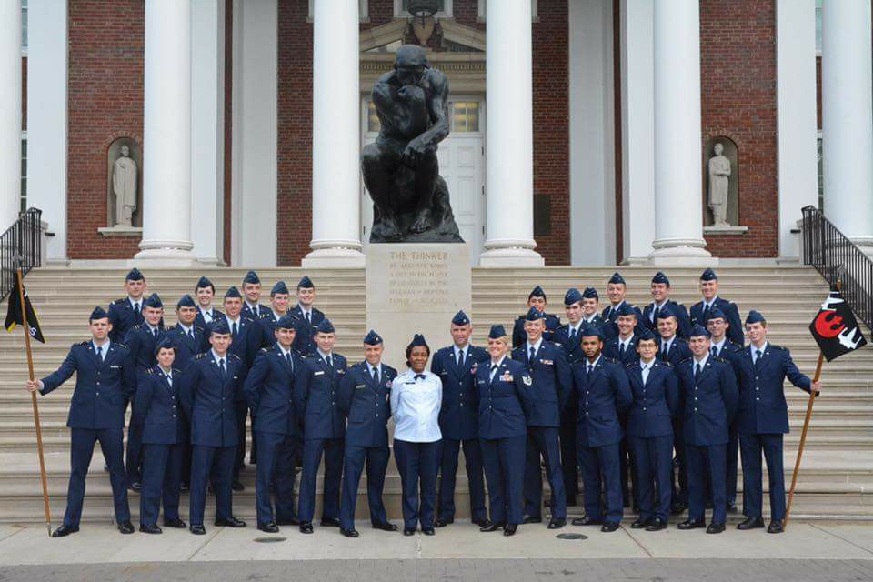
Scholarship Opportunities
Note: HSSP deadline is 1 December your senior year. Apply at AFROTC.com
AFROTC
High School Scholarship
In-College Scholarship
Express Scholarship (Job Specific)
University
May offer Room/Board*
Types of Scholarships:
Full Tuition
$18K
Full In-State Tuition
Scholarship students receive
$900 annually for books and a
monthly stipend
Notes:
*Detachment 295 at the University of Louisville WILL PAY for student’s Room/Board, if they are on scholarship.

Slide 12
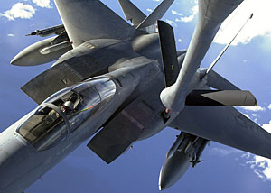
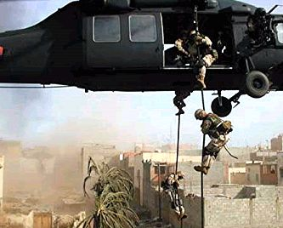
Scholarship Opportunities
Data | Minimum | Average
SAT | 1240 | 1362
ACT | 26 | 31.1
GPA | 3.0 | 3.83
Highly Competitive!

Slide 13
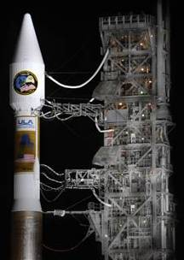
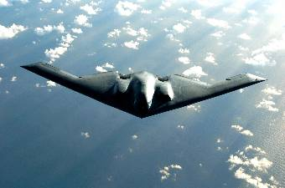
Active Duty Benefits
Pay Grade | Years of Service
 | Under 2 | Over 2 | Over 3 | Over 4 | Over 6
O-8 | 10399 | 10739 | 10965 | 11029 | 11311
O-7 | 8640 | 9042 | 9228 | 9375 | 9643
O-6 | 6552 | 7199 | 7671 | 7671 | 7700
O-5 | 5462 | 6153 | 6579 | 6660 | 6925
O-4 | 4713 | 5456 | 5820 | 5901 | 6239
O-3 | 4144 | 4697 | 5070 | 5528 | 5792
O-2 | 3580 | 4078 | 4696 | 4855 | 4955
O-1 | 3108 | 3235 | 3910 | 3910 | 3910
* Does not include BAH or BAS
Notes:
O-1 is the equivalent of a 2nd Lieutenant, which is the rank you will commission into upon graduation and completion of the program.
BAH: Basic Housing Allowance – monthly stipend you will receive to go towards your living quarters
BAS: Basic Allowance for Subsistence – this is meant to offset the cost for a member’s meal

Slide 14
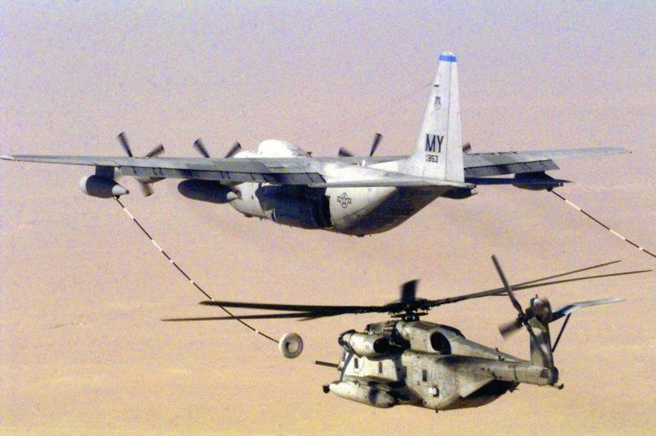
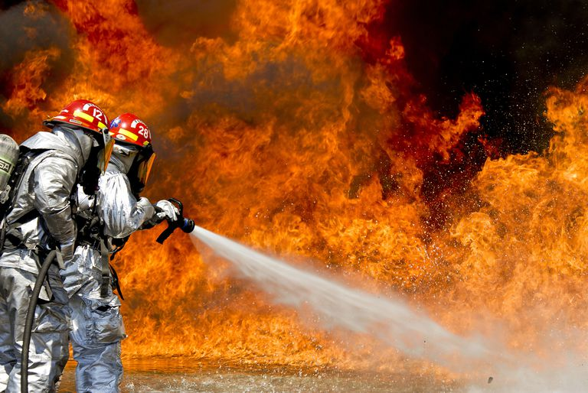
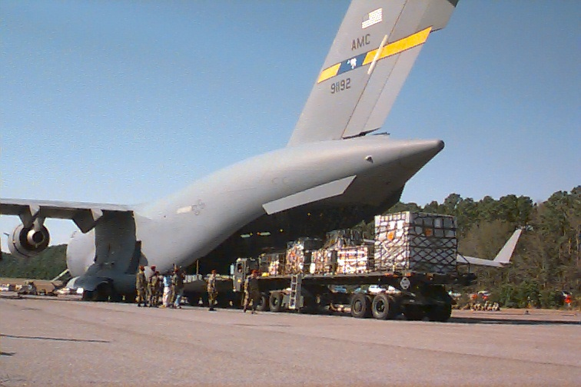
Active Duty Benefits
Rank | Years of Service | Average Pay*
2d LT | 0-2 | ~$58,400
1st LT | 2-4 | ~$72,000
Capt | After 4 | ~$90,600
Free medical/dental care
30 days paid vacation/ yr
Retirement after 20 yrs
New 401k type retirement plan
Notes:
The average pay numbers are taking into account the BAH and BAS national average numbers. This is a rough estimate of what you can expect to make, before taxes, when you are filling the rank above.

Slide 15
Summary
Det 295
What is AFROTC?
AFROTC Requirements
Cadet Progression
Weekly Time Commitment
Career Opportunities
Scholarships
Active Duty Benefits
Cadet Experiences
Q&A

Slide 16
QUESTIONS?
Captain Colin Backert
University of Louisville, Det 295
(502) 852-3601
colin.backert@louisville.edu
www.AFROTC.com

